Slide 1


Envoy
Nikola Velikov, Bozhidar Ivanov
Notes:
Hello everyone and welcome to the last workshop of the semester – Envoy. Today, the two of us – Nikola and Bozhidar, will present to you, what Envoy is, and insights of how to use it as well as a workshop of how to set it up.

Slide 2

Repository link
https://github.com/sebivenlo/ esd-2024-envoy
Notes:
Before we start, please go to the repository and clone it. Then, get the image and repository for the workshop and install them.

Slide 3
Table of contents
1.Microservices & Networking
2.Proxies & Load Balancing
3.Envoy-Specific Concepts
4.Security
5. Configuration & Deployment
6. Performance & Optimization
Notes:
In this slide can be seen everything that will be tackled in the presentation today. Starting off from ….. to …. .

Slide 4
What is Envoy?
Notes:
Envoy is a proxy, intermediary between the service and the client. It has many functionalities, like security, observability, routing and more. It is used in a microservice architecture and service meshes.

Slide 5
Microservices architecture
Advantages
Disadvantages
Accelerate scalability
Improve fault isolation
Enhance team productivity
Quicker deployment time
Increase Cost-efficiency
Increased complexity
Deployment and versioning
Testing complexity
Debugging difficulties
Data management challenges
Notes:
Advantages
1. Accelerate scalability: DevOps teams seamlessly introduce new components without causing any downtime, thanks to the independent operation of each service within the microservices architecture. They can choose each service's best language or technology without compatibility concerns. Deploying services across multiple servers can mitigate the performance impact of individual components and help companies avoid vendor lock-in. 2. Improve fault isolation: Microservices architecture is compartmentalized — if one service encounters a fault or failure, it doesn’t propagate across the entire system. 3. Enhance team productivity: Microservices architecture allows small, focused teams to concentrate on a particular service’s development, deployment, and maintenance without being burdened by the complexities of the entire system. Microservices architecture fosters a sense of ownership and expertise within teams, enabling specialized team members to make informed decisions, iterate quickly, and maintain a high quality of service within their domain. 4. Quicker deployment time: In monolithic architectures, changing necessitates redeploying the entire application. Microservices architecture enables faster releases because each service evolves and deploys independently, reducing the risk and time associated with coordinating changes across an entire application. Decoupling services in this manner enhances agility. You can swiftly roll out updates or fixes with minimal disruption to the overall system. 5. Increase Cost-efficiency: Microservices architecture optimizes resource allocation and maintenance because teams work on small, well-defined services. Efforts are localized to specific services, reducing overall development and system maintenance costs. Teams focus on specific functionality, ensuring resources are used efficiently without redundancy or excess capacity.
Disadvantages
1. Increased complexity: Because microservices are distributed, managing service communication can be challenging. Developers may have to write extra code to ensure smooth communication between modules. 2. Deployment and versioning challenges: Coordinating deployments and managing version control across multiple services can be complex, leading to compatibility issues. 3. Testing complexity: Testing microservices involves complex scenarios, mainly when conducting integration testing across various services. Orchestrating this task can be challenging. 4. Debugging difficulties: It can be demanding to debug an application that contains multiple microservices, each with its own set of logs. A single business process can run across multiple machines simultaneously, compounding complexity. 5. Data management challenges: Data consistency and transactions across multiple services can be complex. Microservices architecture calls for careful data management and coordination to support data integrity.

Slide 6
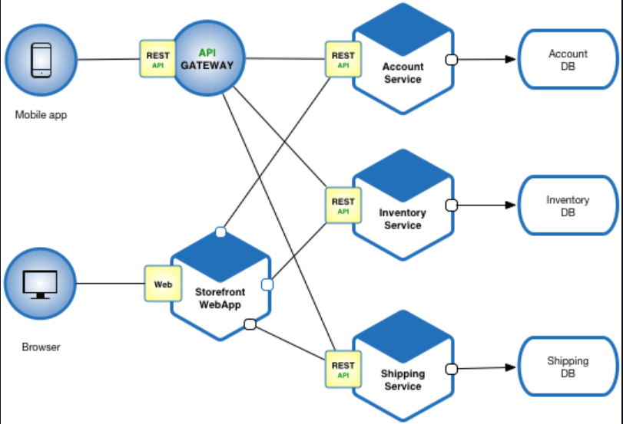
Notes:
Explaining of the diagram

Slide 7
Microservices communication
HTTP/1.1
HTTP/2
gRPC
Notes:
There are 3 types of microservice communication which we will tackle today, HTTP/1.1, HTTP/2. gRPC. They are going to be explained further in the next two slides with practical diagrams

Slide 8

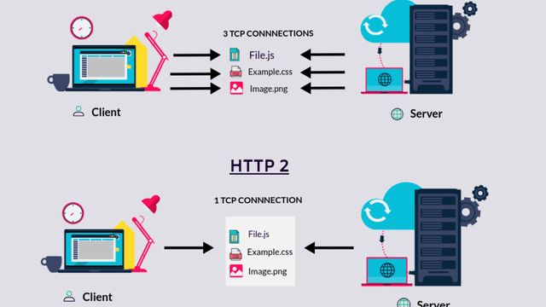
Notes:
HTTP/1.1: HTTP is a top-level application protocol that exchanges information between a client computer and a local or remote web server. In this process, a client sends a text-based request to a server by calling a method like GET or POST. In response, the server sends a resource like an HTML page back to the client. HTTP/1.1, introduced in 1997, enhanced the original HTTP protocol by enabling persistent connections, allowing multiple requests and responses over a single connection, and introducing chunked transfer encoding to support dynamically generated content.
HTTP/2: HTTP/2, standardized in 2015, brought significant performance improvements through features like multiplexing, which allows multiple requests and responses to be sent concurrently over a single connection, reducing latency and improving page load times. Additionally, HTTP/2 uses a binary protocol instead of the textual format of HTTP/1.1, enhancing parsing efficiency and robustness. It also introduced header compression to decrease overhead and server push capabilities to proactively send resources to clients before they are requested.[33] From a technical point of view, one of the most significant features that distinguishes HTTP/1.1 and HTTP/2 is the binary framing layer, which can be thought of as a part of the application layer in the internet protocol stack. As opposed to HTTP/1.1, which keeps all requests and responses in plain text format, HTTP/2 uses the binary framing layer to encapsulate all messages in binary format, while still maintaining HTTP semantics, such as verbs, methods, and headers. An application level API would still create messages in the conventional HTTP formats, but the underlying layer would then convert these messages into binary. This ensures that web applications created before HTTP/2 can continue functioning as normal when interacting with the new protocol. The conversion of messages into binary allows HTTP/2 to try new approaches to data delivery not available in HTTP/1.1, a contrast that is at the root of the practical differences between the two protocols.

Slide 9

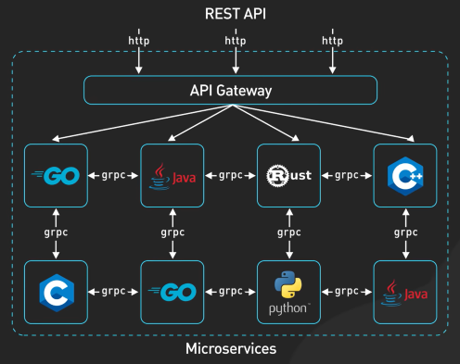
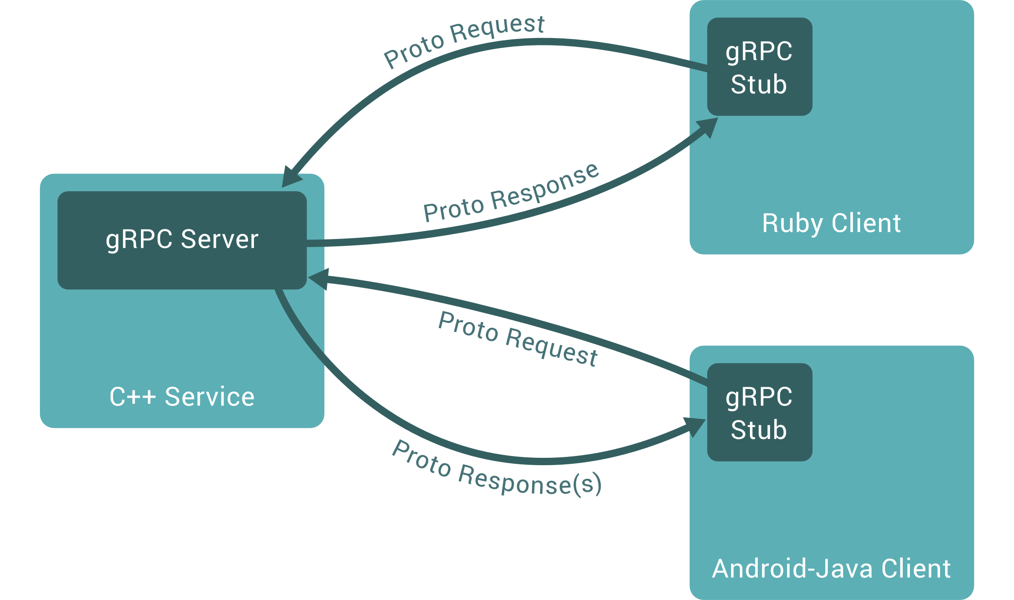
Notes:
What is gRPC: It is the most popular implementation of the RPC (Remote Procedure Call) concept. It is based on HTTP/2, although it is not supported by default on any browsers, so it is used mostly for communication between microservices. In gRPC, a client application can directly call a method on a server application on a different machine as if it were a local object, making it easier for you to create distributed applications and services. As in many RPC systems, gRPC is based around the idea of defining a service, specifying the methods that can be called remotely with their parameters and return types. On the server side, the server implements this interface and runs a gRPC server to handle client calls. On the client side, the client has a stub (referred to as just a client in some languages) that provides the same methods as the server.
The most common method is of course RESTful APIs using HTTP/1.1, but many modern microservice architectures combine the above-mentioned methods. Rest is used for external APIs, while gRPC is used for internal service-to-service communication. Messaging Queues are sometimes used for decoupled or asynchronous tasks.

Slide 10
Service discovery
Two main Service Discovery patterns:
Client-Side Discovery
Server-Side Discovery
Notes:
Service discovery
There are two main service discovery patters, client-side , server-side, in the next two slides they will be explained further with diagrams, showing exactly what they look like.

Slide 11
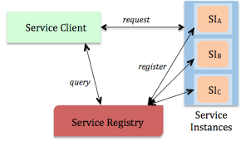
Client-side Discovery
Notes:
The Service Consumer is responsible for determining the network locations of available service instances and load balancing requests between them. The client queries the Service Register. Then the client uses a load-balancing algorithm to choose one of the available service instances and performs a request.

Slide 12

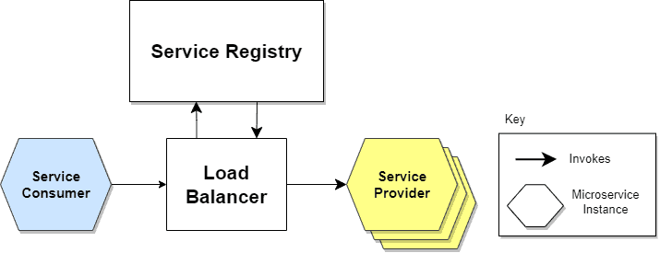

Server-side Discovery
Notes:
Uses an intermediary that acts as a Load Balancer. The client makes a request to a service via a load balancer that acts as an orchestrator. The load balancer queries the Service Registry and routes each request to an available service instance.
Envoy is used in Server-Side Discovery, as a load-balancer, which is also involved in the service discovery process.

Slide 13
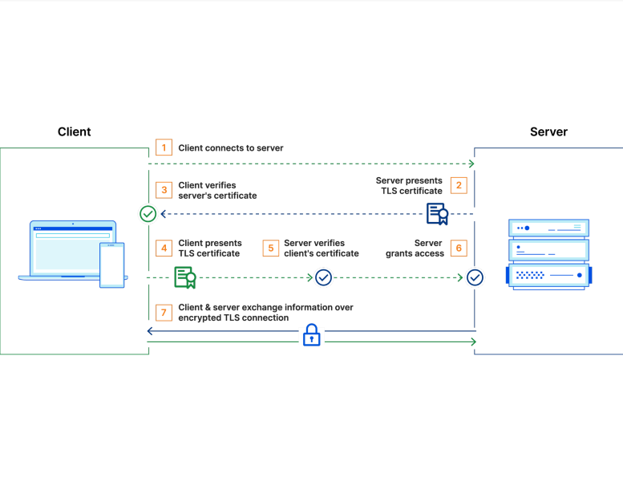
Service-to-service authentication
Notes:
Service-to-Service Authentication is critical in microservice architectures to ensure secure communication between services and prevent unauthorized access.
Envoy provides multiple ways to secure services, which include TLS/mTLS, JWT, OAuth2 and custom authorization filters.
mTLS (Mutual TLS): Mutual TLS, or mTLS for short, is a method for mutual authentication. mTLS ensures that the parties at each end of a network connection are who they claim to be by verifying that they both have the correct private key. The information within their respective TLS certificates provides additional verification. mTLS is often used in a Zero Trust security framework* to verify users, devices, and servers within an organization. It can also help keep APIs secure<.
*Zero Trust means that no user, device, or network traffic is trusted by default, an approach that helps eliminate many security vulnerabilities.
JWTs: Services include a JSON Web Token (JWT) in their requests. Envoy validates the JWT signature and claims using a public key or a JWKS endpoint.
Custom filters: Envoy allows custom gRPC-based authorization checks to be performed before forwarding requests to the upstream service. This is useful for applying business-specific authentication logic.
CONSIDER MOVING IT TO SECURITY

Slide 14
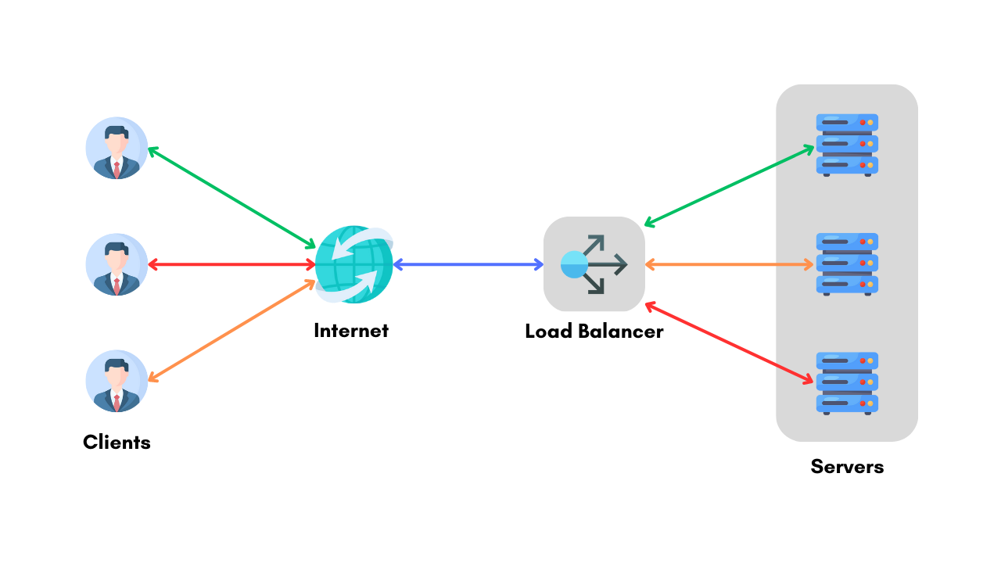
Proxies & Load Balancing
Notes:
Proxies & Load Balancing

Slide 15
Types of proxies & Envoy
Forward Proxy
Edge Proxy
Sidecar Proxy
Notes:
There are three types of proxies which will be tackled in this presentation, forward, edge, sidecar proxies. In the following slides every single one of them will be explained with a diagram, showing what it looks like.

Slide 16
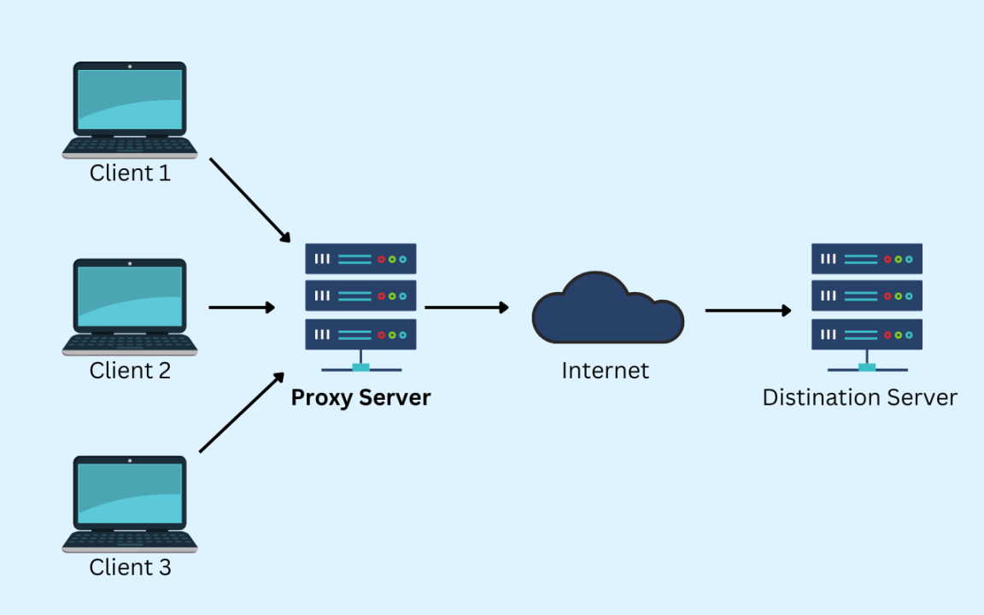
Forward Proxy
Notes:
Forward Proxy: a forward proxy is a client-side intermediary used to control and monitor outbound requests from applications or users within a private network to external systems, such as APIs or web servers. It plays a significant role in enforcing access control, logging traffic, caching data for improved performance, and anonymizing requests by masking client identities. For example, can be configured to enforce internet usage policies or optimize API call efficiency in large-scale systems. In simple terms, it acts on behalf of clients to send requests to servers.

Slide 17
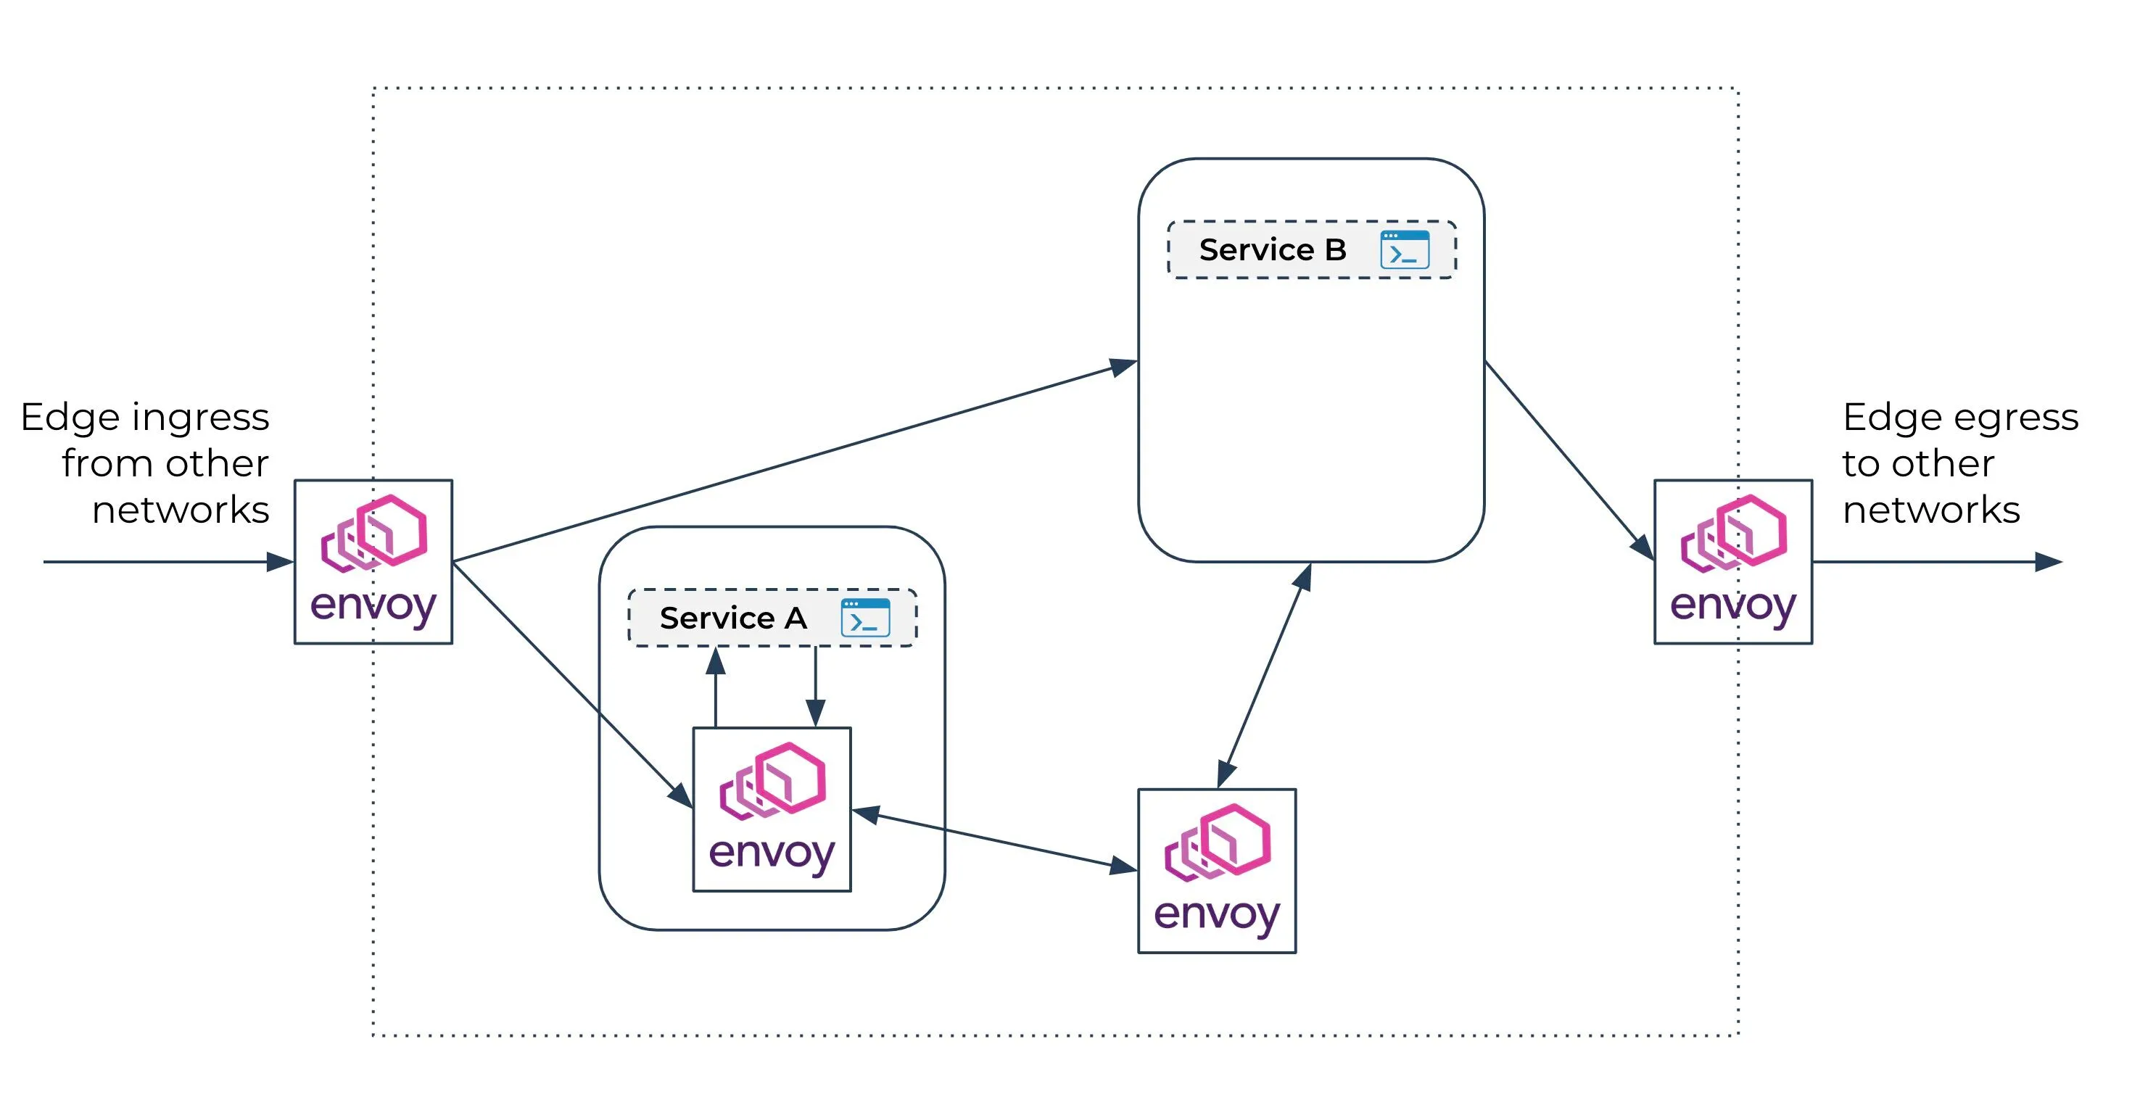
Edge Proxy
Notes:
Edge Proxy: A type of reverse proxy that operates at the boundary of a network (often at the "edge" of a cloud or enterprise network). It is a server-side intermediary responsible for managing inbound client requests to backend services. Edge proxies are utilized to handle critical concerns like load balancing, authentication, SSL termination, and request routing. By abstracting these functions from backend servers, edge proxies enhance scalability, security, and maintainability. They are an essential component in distributed systems and microservices, ensuring high availability and robust handling of client traffic. They can also serve as API Gateways in many cases.

Slide 18
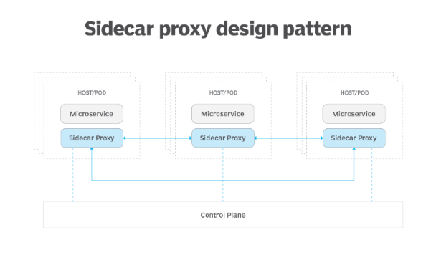
Sidecar Proxy
Notes:
Sidecar Proxy: A sidecar proxy is closely associated with service mesh architectures in microservices, where it runs alongside an application instance as a separate process or container. Sidecar proxies are responsible for service discovery, traffic routing, security enforcement (e.g., mutual TLS), and telemetry collection. Using sidecar proxies allows decoupleing these concerns from application code, enabling a standardized way to implement cross-cutting functionalities across services. Sidecar proxies are pivotal in improving observability, resilience, and maintainability in microservices-based applications.
Envoy is primarily designed to function as both an edge proxy and a sidecar proxy, depending on the deployment scenario.

Slide 19
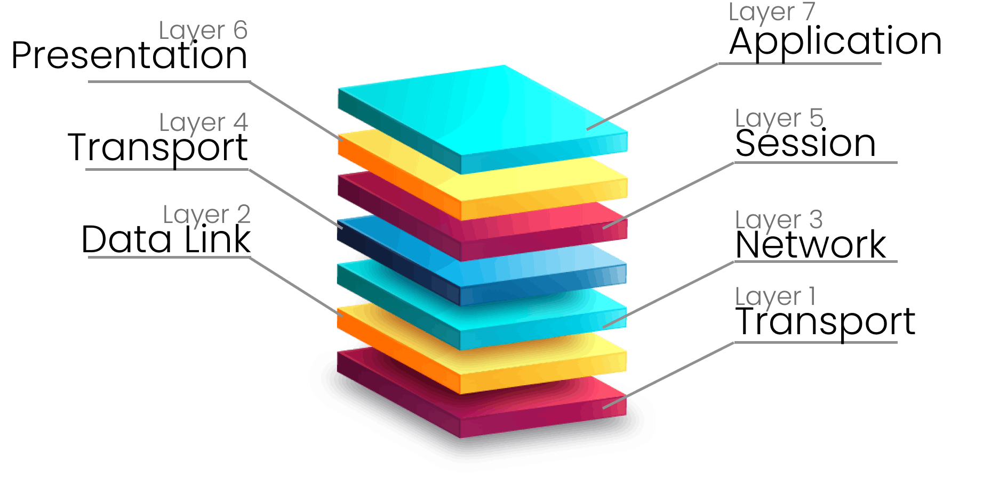
Key functions of a Layer 7 proxy
Notes:
Layer 7 proxies, like Envoy, operate at the application layer, offering advanced features not possible with Layer 3/4 proxies, which work only with transport-layer data like IP addresses and ports. Layer 7 proxies can inspect and manipulate application data (e.g., HTTP headers, paths, cookies), enabling intelligent traffic routing, caching, and security enforcement. For example, they can route specific API requests to different backends, cache frequently accessed content, terminate TLS connections, and enforce authentication or authorization policies such as validating JWT tokens. These proxies also implement sophisticated load-balancing strategies, such as round-robin, least-connections, or weight-based routing, often based on real-time application metrics.
Additionally, Layer 7 proxies integrate with service discovery systems, dynamically routing traffic to healthy and available endpoints, and provide detailed observability through metrics, logging, and distributed tracing. They also enhance system resilience by enabling retries, timeouts, and circuit breakers. While these features provide granular control and improve performance in microservice architectures, Layer 7 proxies are more resource-intensive, as they require more processing power to inspect application data. In contrast, Layer 3/4 proxies, which simply route traffic based on IP and port, are faster and more efficient but lack application-layer awareness.

Slide 20
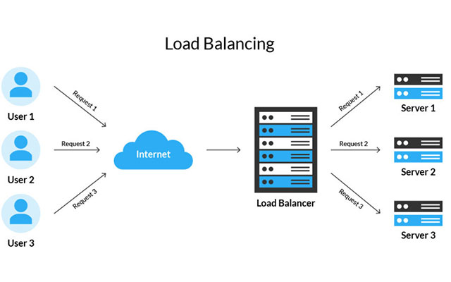
Envoy’s load balancing
What is load balancing?
Notes:
Load balancing is the process of distributing network traffic across multiple backend servers to ensure reliability, scalability, and optimal utilization of resources. In a microservices architecture, it is essential because services often need to handle large volumes of traffic while maintaining low latency and high availability. Multiple instances of the same microservice are deployed to manage this load, and a load balancer ensures that requests are evenly distributed among them. Envoy, as a modern proxy, supports several load-balancing strategies tailored for various use cases, including round-robin, least-request, random, ring hashing, Maglev, and weighted load balancing.

Slide 21
Load balancing strategies
Round-Robin
Least-Request
Random
Ring Hashing
Maglev
Weighted Load Balancing
Notes:
Load Balancing Strategies – add some desc on the slide
Round-Robin: It sequentially distributes requests to each server in the backend in a looping fashion. This strategy is simple to implement and effective when all servers have similar capacity. However, it does not account for differences in server load, which can lead to performance bottlenecks if some requests are more resource-intensive than others.
Least-Request: This strategy routes traffic to the server with the fewest active requests. It ensures an even workload distribution and is particularly effective in environments where request processing times vary significantly. However, its implementation requires real-time monitoring of server loads, which adds complexity to the system.
Random: This strategy randomly selects a server to handle each incoming request. It is straightforward and fair over time, as all servers receive approximately the same number of requests in the long run. However, because it does not consider server load or request type, it can lead to uneven distribution in the short term, especially with small server pools.
Ring Hashing: This strategy uses consistent hashing to route requests, ensuring that a client consistently communicates with the same server, which is useful for maintaining session affinity. Ring hashing minimizes disruption when servers are added or removed. However, it can lead to imbalanced traffic distribution if the hash space is unevenly divided among servers.
Maglev: Maglev is a hashing-based strategy that provides uniform traffic distribution and minimizes rebalancing when backend servers are added or removed. It is highly efficient for high-traffic environments and excels in reducing disruptions during server scaling. However, it is more complex to implement and may require specific tuning to achieve optimal performance.
Weighted Load Balancing: This strategy assigns weights to servers, directing more traffic to servers with higher capacity or preference. It is particularly beneficial in heterogeneous environments where servers have varying capabilities or for geographically distributed traffic. Its primary drawback is the need for manual weight configuration, which can become challenging in dynamic or large-scale environments.

Slide 22
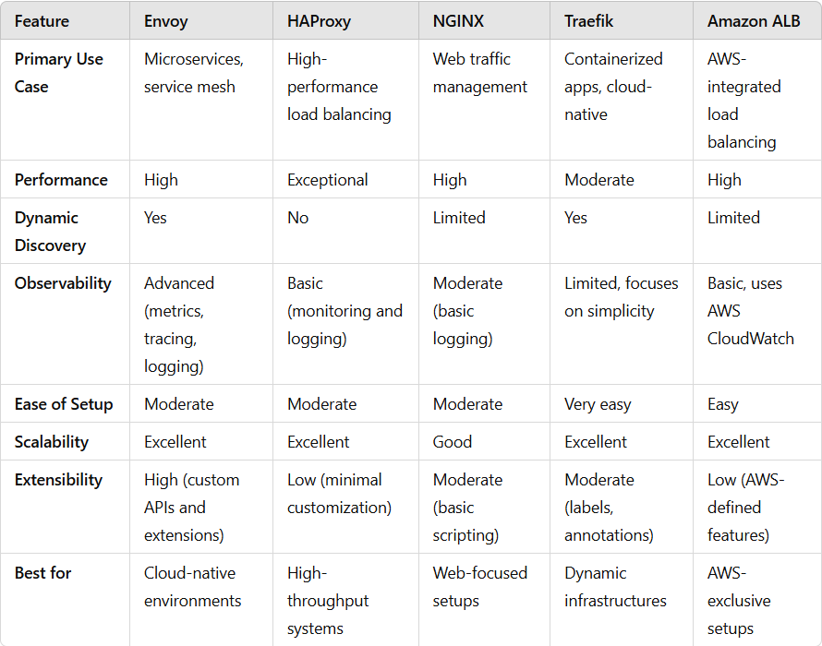
Comparison between proxies - Envoy
Notes:
To be done

Slide 23

Envoy-Specific Concepts

Slide 24
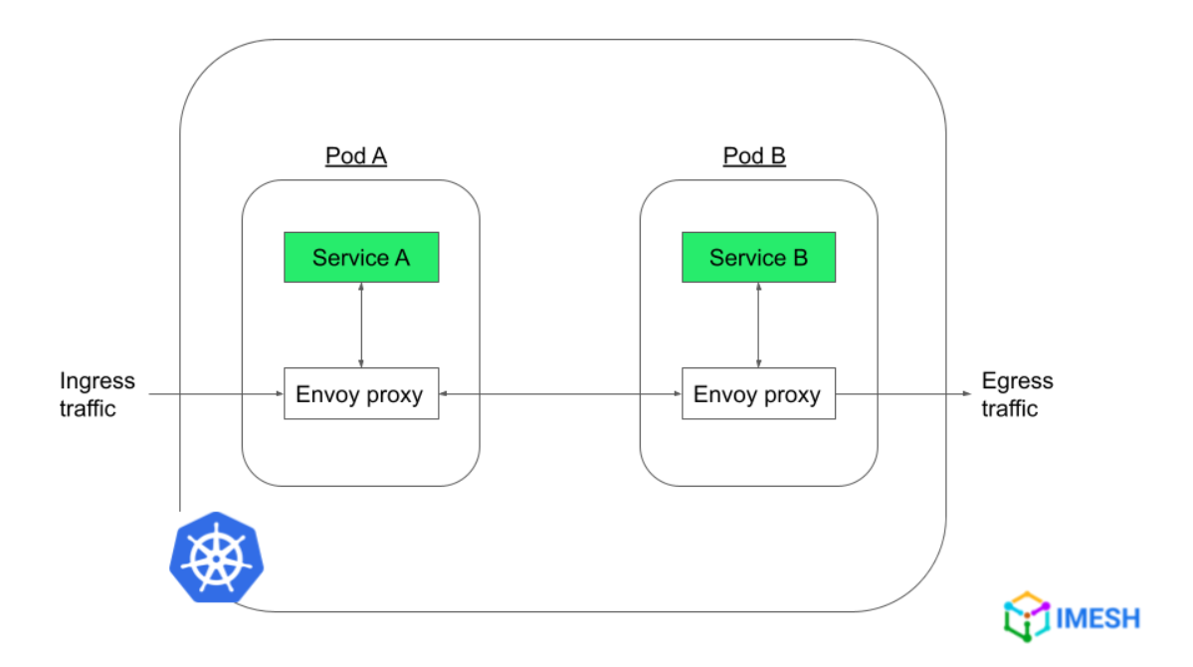
Issue that Envoy resolves and purpose
Handle the complex networking challenges of modern microservice-based architectures
Serves the purpose of a communication bus for microservices across the cloud, to communicate with each other in a rapid, secure, and efficient manner

Slide 25
Envoy’s traffic routing between services
1. Version upgrades: traffic to a route is shifted gradually from one cluster to another
2. Multivariate testing: two or more version of the same service are tested simultaneously. The traffic to the route must be split between clusters running different versions of the same service.
Notes:
Explanation of each one of them with the pictures and concept explanation

Slide 26
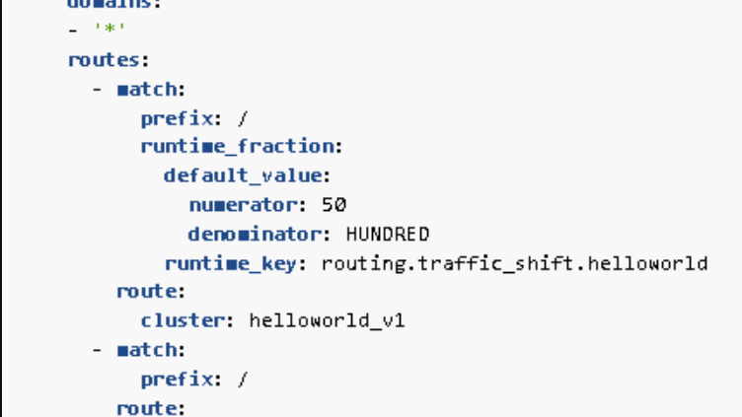
Version upgrades

Slide 27
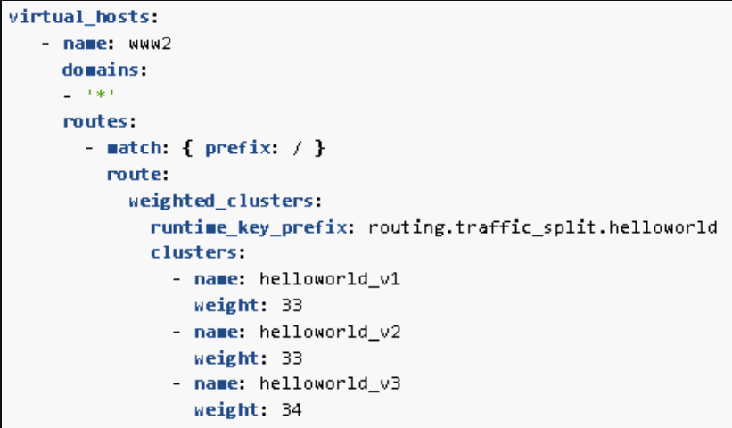
Multivariate testing

Slide 28
Envoy’s handling of resilience features
Circuit Breaking
Retires
Retries in gRPC services
Outlier Detection
Notes:
One of the biggest advantages of using Envoy in a service mesh is that it frees up services from implementing complex resiliency features like circuit breaking, outlier detection and retries that enable services to be resilient to realities such as rolling upgrades, dynamic infrastructure, and network failures. Having these features implemented at Envoy not only improves the availability and resiliency of services but also brings in consistency in terms of the behavior and observability.

Slide 29
Envoy’s observability
Metrics
Logging
Traces
Notes:
Metrics - Envoy handles metrics data by default through its built-in statistics and metrics collection feature.
Logging - Understanding what’s happening in your microservices also requires effective log management. Envoy Gateway handles logs by default through its access logging feature and sends logs to stdout in default text format. Traces - Traces provide a chronological view of requests and are essential for debugging and performance optimization.

Slide 30
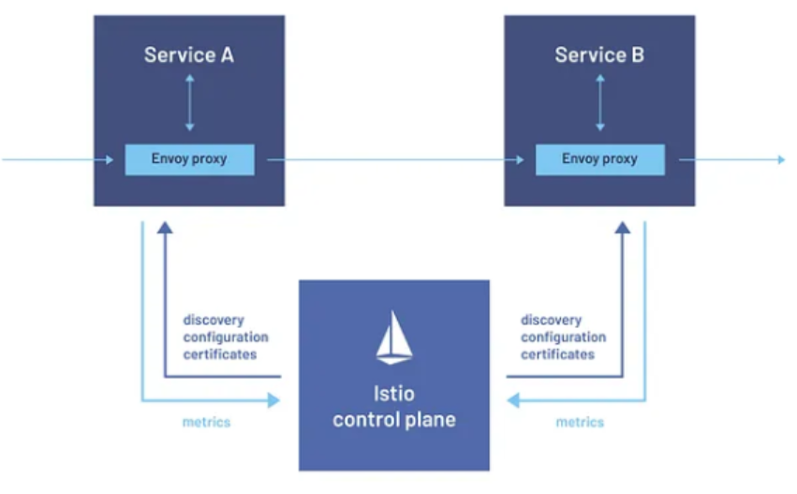
Envoy’s role in a service mesh
Ensure reliable and fast communication between services
Have high observability on requests through these service.
In case of issues, being quickly able see what is failing and where
Easily configure and change request routes.
Have resilient communication practices in place, like circuit breaker , retry mechanism etc.
Notes:
Service mesh is a dedicated infrastructure layer for managing service-to-service communication within a microservices architecture. It is typically implemented using a collection of interconnected proxy servers. The service mesh provides advanced traffic management features such as service discovery, load balancing, traffic shifting, and fault tolerance, among others.

Slide 31

Notes:
Security

Slide 32

Security implications of using a reverse proxy
Exposure
Notes:
Exposure of Proxy:
- The reverse proxy becomes a single entry point, making it a potential target for attacks like DDoS or exploitation of vulnerabilities in the proxy software.
- Misconfiguration Risks: Errors in routing, authentication, or access control policies can lead to unauthorized access or data leaks.
However, with envoy, the security risks are mitigated by robust support for mTLS, rate limiting, request validation, and rich observability. However, proper configuration, regular updates, and monitoring are critical to maintaining its security posture.

Slide 33
Envoy’s handling of TLS and mTLS terminations
TLS termination
Mutual TLS termination (mLTS)
Notes:
TLS termination:
1.Incoming Connection Termination: Envoy acts as the endpoint for client connections by terminating the TLS session. This involves: -Decrypting traffic using the server certificate and private key. -Configuring TLS settings like supported protocols (e.g., TLS 1.2, 1.3) and cipher suites.
2.Configuration: You can specify the TLS certificates and private keys in the listener.
Mutual TLS (mLTS):
1.Client Authentication: Envoy supports mTLS by verifying the client certificate during the handshake process.
2.Trust Validation: -Envoy uses a Certificate Authority (CA) certificate bundle to validate the client's certificate. -The client's certificate must meet criteria such as validity and signing authority.

Slide 34
Authentication and Authorization policies
Authentication:
JWT Authentication
mTLS Authentcation
Authorization:
RBAC (Role-Based Access Control)
External Authorization
Why should you use Envoy for Authentication and Authorization?
Notes:
Authentication in Envoy typically involves verifying the identity of a request, either by checking credentials (e.g., tokens, certificates) or integrating with an external Identity Provider (IdP).
Filtering users:
JWT Authentication Filter:
-Validates JSON Web Tokens (JWT) presented in the request headers or cookies. -Configured to check for token validity (signature, issuer, audience, expiry, etc.). -Supports integration with OAuth2 and OpenID Connect workflows.
mTLS Authentication:
-Mutual TLS (mTLS) can be enforced using Envoy’s transport socket configuration. -Validates client certificates against a trusted Certificate Authority (CA). [13]
Authorization:
RBAC (Role-Based Access Control) Filter:
-Implements fine-grained access control based on roles, actions, or resource attributes. -Rules can use dynamic metadata from JWT claims, headers, or other sources.
External Authorization Filter:
-Delegates authorization decisions to an external service (e.g., OPA, custom authz service). -Communicates over gRPC to fetch allow/deny decisions based on the request context.
Why use Envoy for Authentication and Authorization?
-Centralized Policy Enforcement: Consistently applies policies across multiple microservices. -Scalability: Offloads authentication/authorization to Envoy to keep downstream services simple. -Extensibility: Supports custom logic via external authorization services. -Compliance: Ensures compliance with security and access policies.

Slide 35

Configuration & Deployment
Notes:
Add an image here

Slide 36
How is typically Envoy deployed?
Sidecar Proxy
Edge Proxy

Slide 37
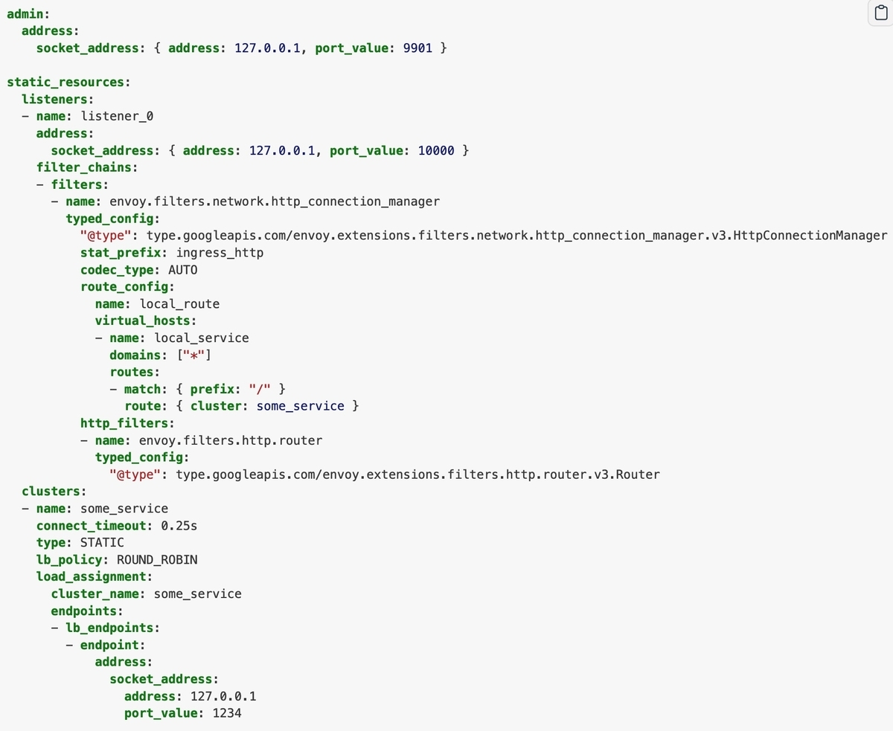
Envoy’s config file structure
YAML Based
Listeners
Filters
Routes
Clusters
Endpoints

Slide 38
Dynamic configuration and control plane interaction in Envoy
Uses xDS API to fetch dynamic configuration from a control plane.
This dynamic interaction allows Envoy to adapt to changes in real-time without needing to restart.

Slide 39
Envoy’s integration with orchestration system like Kubernetes
Tools like Istio manage Envoy proxies automatically to:
Discover services via Kubernetes APIs.
Handle service-to-service communication by intercepting and routing traffic.
Provide observability with logs and metrics.
Enforce policies and apply security features like mTLS.

Slide 40

Performance
Notes:
Here we will see how Envoy is compared to other reverse proxies when sending a number of HTTP and HTTPS requests, in our case 250 concurrency range.

Slide 41
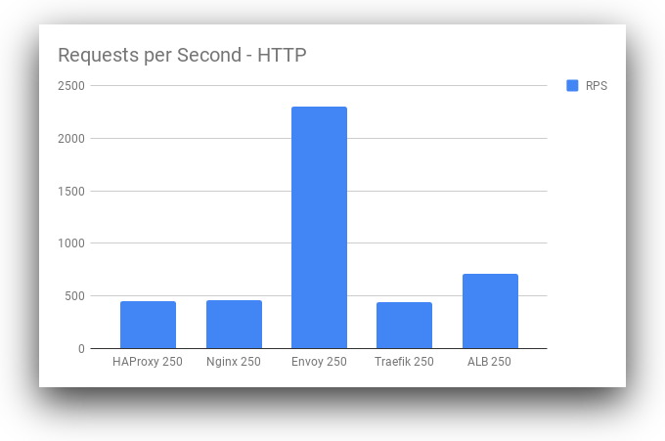
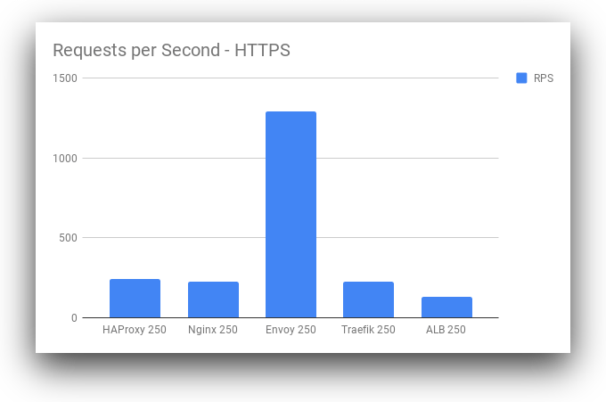
Performance comparison
Notes:
HTTP: Envoy has a far higher throughput than all other load balancers at the 250 concurrency range. While Envoy is also higher at other concurrency levels, the magnitude of the difference is especially high at the 250 concurrency level. This may be due to some intelligent load balancing or caching inside of Envoy as part of the defaults. It warrants further investigation to determine if this result is representative of real-world performance outside our limited benchmark.
HTTPS: Envoy still remains in the lead by throughput with HTTPS. However, the performance profiles for HTTPS are much lower across the board. From a base performance level, our requests per second tend to drop significantly, up to 30% in some cases. This may be a combination of factors: SSL libraries used by the load balancer, ciphers supported by the client and server, and other factors such as key length for some algorithms.

Slide 42
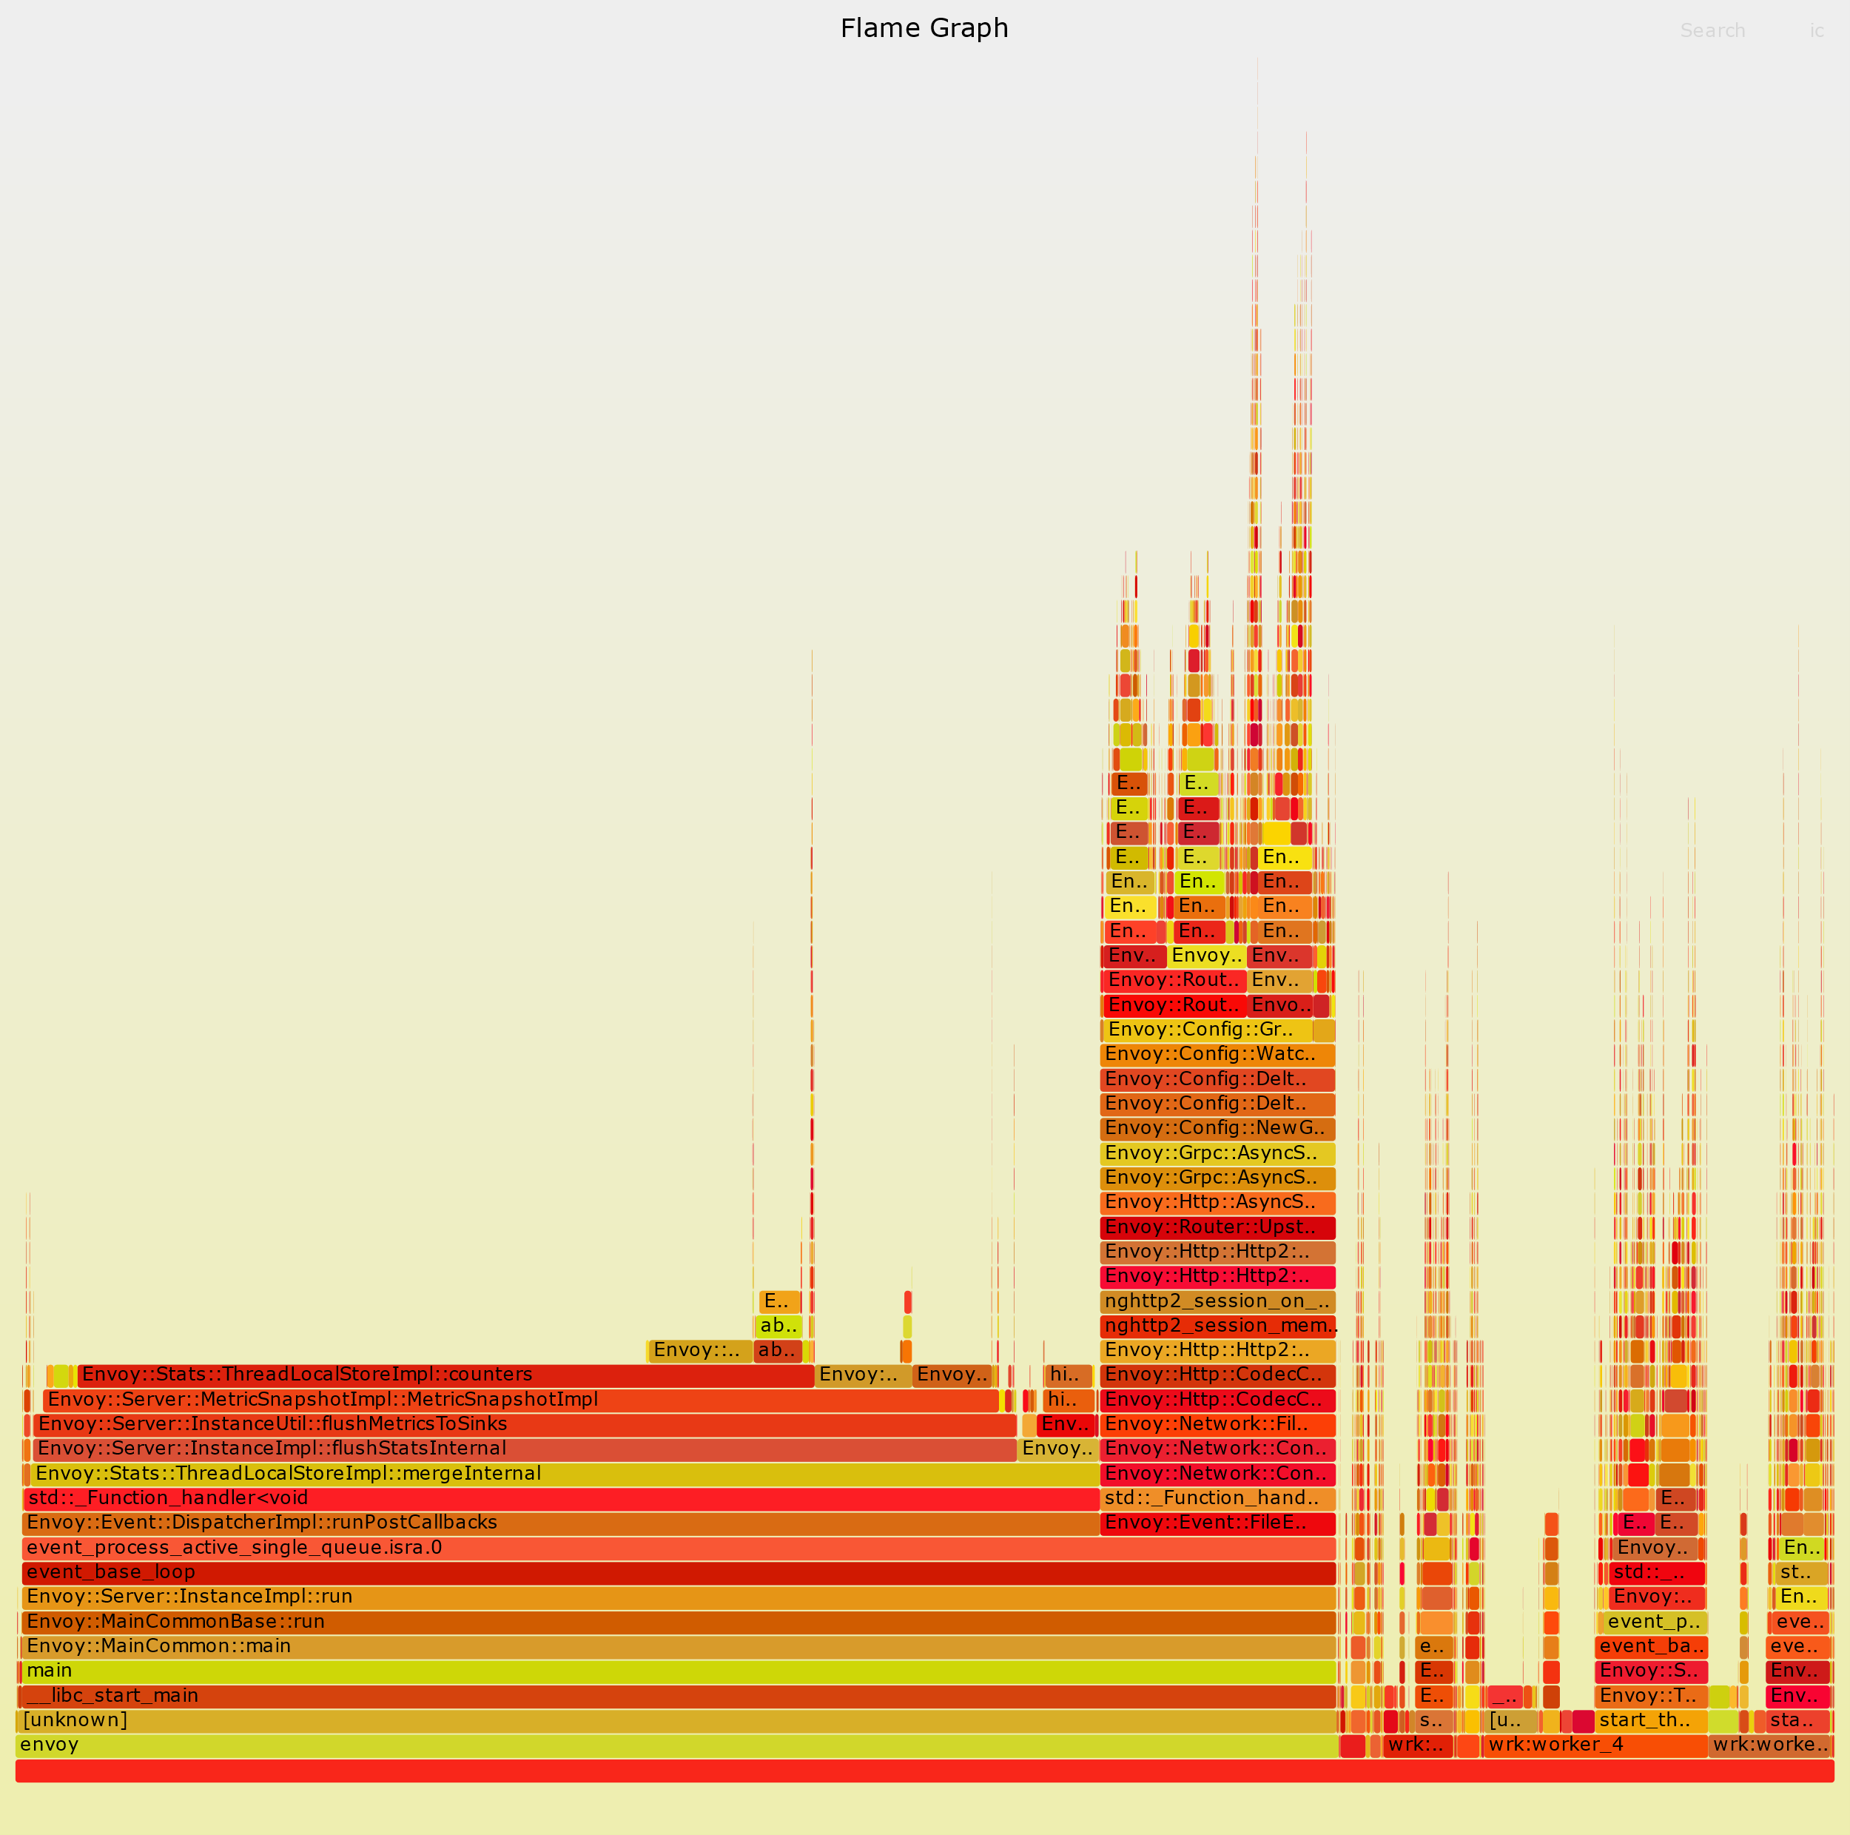
Notes:
A flame graph visualizes a distributed request trace and represents each service call that occurred during the request's execution path with a timed, color-coded, horizontal bar. Flame graphs for distributed traces include error and latency data to help developers identify and fix bottlenecks in their applications.

Slide 43

{LINK TO QUIZ}
Notes:
So now, please everyone head in to the Quiz.

Slide 44


Slide 45


